Slide 1
Career Pathways for the Evolving World of Work
Rachel Pleasants McDonnell

Slide 2
MY
CAREER PATH

Slide 3
JFF: BUILDING A FUTURE THAT WORKS
OUR WORK
We drive meaningful change in the American workforce and education systems. For 35 years, JFF has led the way in designing innovative and scalable solutions that create access to economic advancement for all.
OUR VISION
The promise of education and economic mobility in America is achieved for everyone.

Slide 4
THE EVOLVING WORLD OF WORK

Slide 5
THE EVOLVING WORLD OF WORK

Slide 6
THE EVOLVING WORLD OF WORK

Slide 7
THE EVOLVING WORLD OF WORK

Slide 8
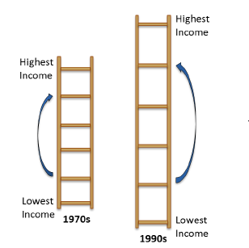
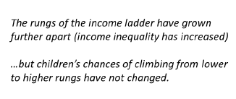
CHANGES IN THE INCOME LADDER IN THE U.S.
SOURCE: The Equality of Opportunity Project, n.d.

Slide 9
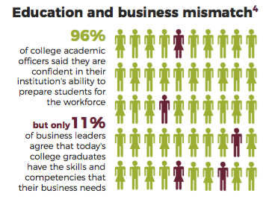
Future of Work: New Findings
FUTURE OF WORK
WHAT WE KNOW

Slide 10
MAJOR THEMES SHAPING
THE FUTURE OF WORK
Automation, Robotics, AI
Employment
Status
Nature of Work
Accelerating
Change

Slide 11
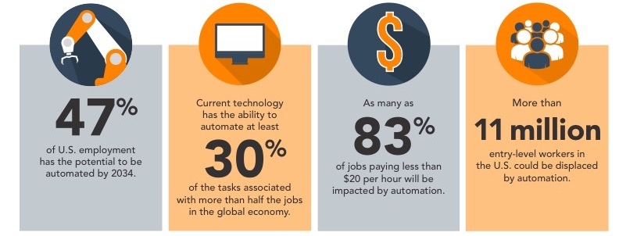
TRENDS IN THE FUTURE OF WORK

Slide 12
SUCEPTIBILITY TO AUTOMATION
Telemarketers: 99%
Cashiers: 97%
Delivery Drivers: 98%
Restaurant Cooks/Food Prep: 96%
Janitorial Staff: 94%
Hotel Clerks: 94%
Carpenters: 72%
Machinists: 64%
Clergy: 0.8%

Slide 13
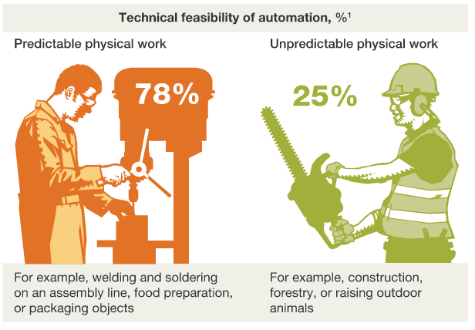
Source: McKinsey (2016), http://www.mckinsey.com/business-functions/digital-mckinsey/our-insights/Where-machines-could-replace-humans-and-where-they-cant-yet

Slide 14
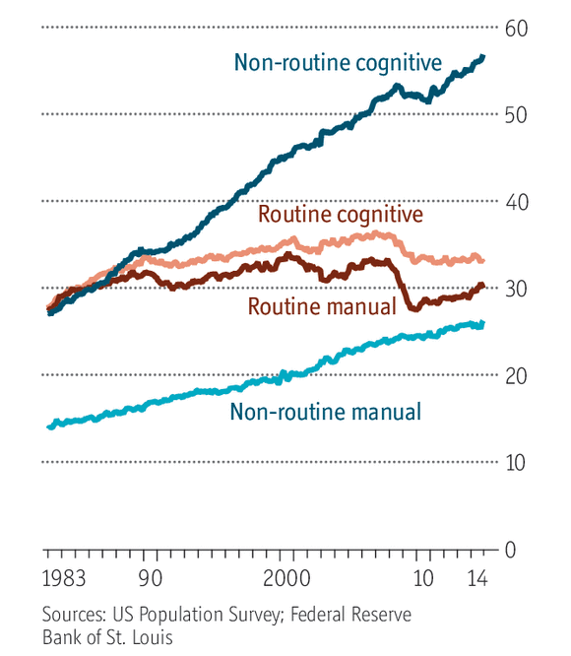
U.S. Employment, by type of work
A CHANGING
ECONOMY

Slide 15
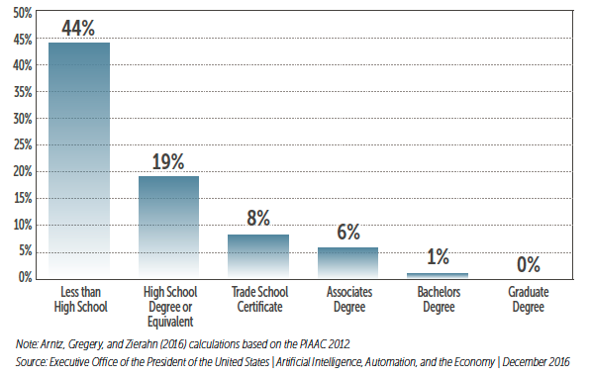
TRENDS IN THE FUTURE OF WORK
SHARE OF JOBS WITH HIGHLY AUTOMATABLE SKILLS, BY EDUCATION

Slide 16
THE 1099 ECONOMY
A growing share of the economy
Goes beyond the Gig Economy
Growth rate is accelerating
Notes:
http://www.wsj.com/articles/contract-workforce-outpaces-growth-in-silicon-valley-style-gig-jobs-1458948608

Slide 17
ALTERNATIVE WORK ARRANGEMENTS
EMPLOYERS BENEFIT
On demand work
Lower costs
Easier to hire/fire
EMPLOYEES DO NOT
Loss of pension
Loss of healthcare
Loss of unemployment insurance
Loss of retirement assistance
No overtime, holiday or sick leave
Other lost benefits

Slide 19
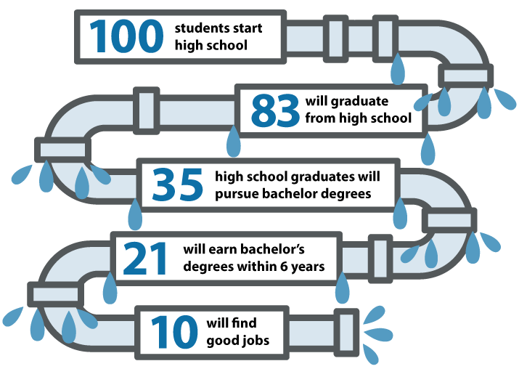
RE-ENGAGING
THE OTHER 90%
Source: http://www.stradaeducation.org/leaders-in-higher-education-innovation-offer-wish-list-for-new-president/

Slide 20
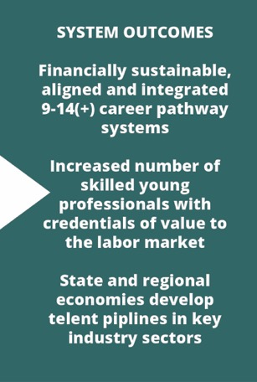
SEAMLESS TO/THROUGH CREDENTIALS

Slide 21
THE ELEMENTS OF THE SYSTEM
Sourced from: Lantham, N. (2014). “A Practical Guide to Evaluating Systems Change in a Human Services System Context.” Center for Evaluation Innovation.

Slide 22
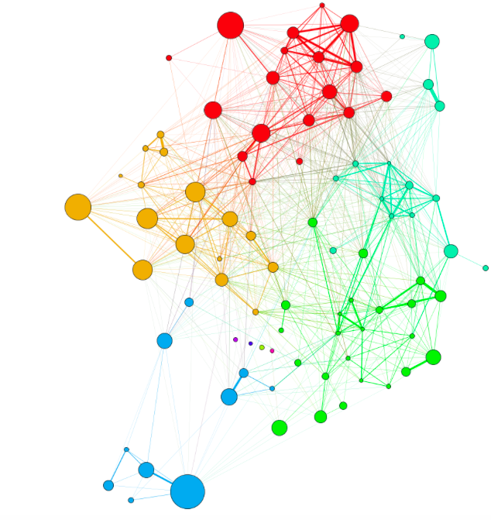
PATHWAY ECOSYSTEM KEY DESIGN ELEMENTS
Co-designed with secondary, postsecondary, adult education, workforce development, and industry/employers
Leverage state and regional policy
Regionally focused; Labor market aligned
Stackable credentials
Multiple on- and off-ramps

Slide 23
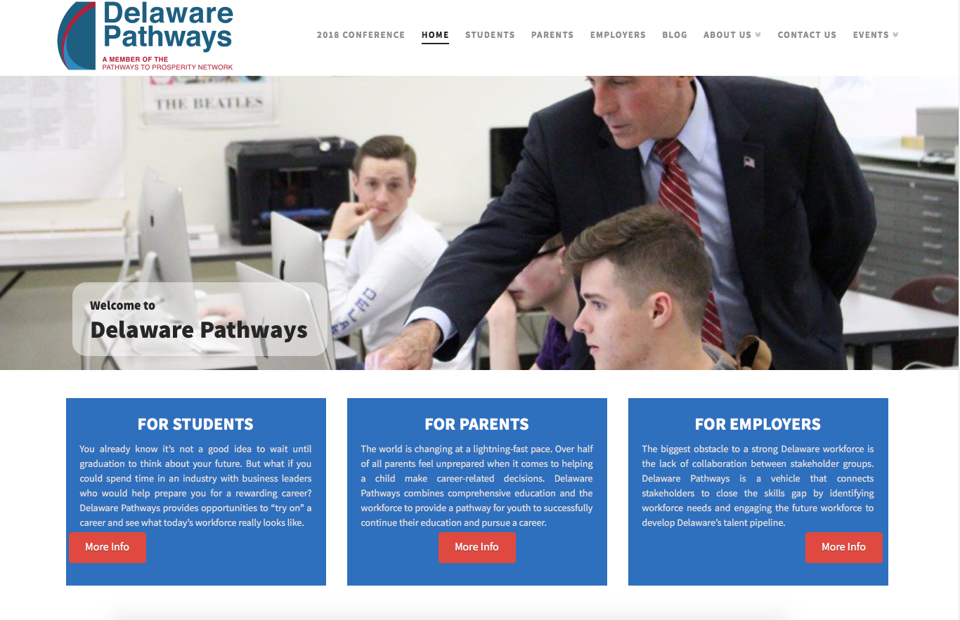

Slide 24
Future of Work: New Findings
SKILLS FOR THE FUTURE OF WORK

Slide 25
WHAT WORKS FOR ADULT LEARNERS
Pathway Entry
Some career pathway programs provide preparatory education and training, including bridge programs, designed to help students move from entry level, including non-college credit, to credit-bearing postsecondary coursework and employment
Integrated Training
Integrated training ensues through authentic partnerships involving employers, workforce training, adult education, postsecondary education, and other providers who offer industry-recognized credentials in high-demand occupations leading to family-supporting jobs and career opportunities
Career Progression
Career progression includes programming that enables learners/workers to advance in postsecondary education and training to secure multiple, often stacked credentials, including degrees, needed to transition to and through careers capable of providing financial stability

Slide 26
PROGRAM ELEMENTS
Engaged education-employer-workforce-community partnerships
Contextualized, accelerated, and competency-based instruction
Work-based learning options
Industry- and postsecondary-recognized credentials
Case management, navigation, and proactive student supports
Job placement and continuing career guidance
Rigorous evaluation and continuous improvement

Slide 27
REVERSE-ENGINEERED PATHWAYS DESIGN
EMPLOYERS
Future Of Work Considerations
Competency Mapping
Sector Strategies
Work-based Learning
POSTSECONDARY
Connection To Labor Market
On-ramps and Off-ramps
Seamless Transitions
Partnership building
ADULT EDUCATION
Both College And Career
Integrated Pathways
Early, Ongoing Career Advising
Contextualized Foundational Skills

Slide 28
Expanding the VILLAGE
Business & Industry
Colleges & Universities
Social Services
Community -Based Organizations
K-12 Schools
Intermediaries
WFD & Economic Development
Afterschool Networks
One-stops
Adult education
Cross-sector approach to building pathways with clear value proposition for each partner

Slide 29
PREPARING EVERYONE TO BE FUTURE-READY
What advise can you provide to your jobseekers about pathways from education to careers, and career possibilities?
How can you talk about the critical role of productive work in human lives?
How can you help jobseekers understand the future labor market—or even the current one?
How can you learn more about contemporary high-growth industries, labor market data and shifts in education and workforce?

Slide 30
POSSIBLE FUTURES of WORK
How Can we Close this Aspiration gap?
Current Mindset: I need to get a job now so I can pay my rent and support my family
Future-Oriented Mindset: I need to get myself onto a career path so that my family is able to thrive.

Slide 31
A QUICK RECAP
The labor market is changing rapidly
We don’t totally know what’s in store, but we have some good predictions
We need to build career pathways systems that can adapt to the changing world of work
That means thinking about how our organizations work, and how we all work together

Slide 32
WHERE SHALL WE GO? HOW SHALL WE GET THERE?

Slide 33
Rachel Pleasants McDonnell
Associate Director, Jobs for the Future
rmcdonnell@jff.org

